Slide 1
Cosc 3P92
Week 3 Lecture slides
An intelligence test sometimes shows a man how smart he would have been not to have taken it.
Laurence J. Peter
US educator & writer (1919 - 1988)

Slide 2
Microprocessor chips
implemented using same general principles as basic logic circuits, except for complexity and timing considerations.
low-level descriptions: via pinout
  all communications done via pins
  3 pin categories: address, data, control
interface between microprocessor and memory/IO via the bus

Slide 3
Microprocessor chips
all communication: setting signals on control, addr, data lines.
  example: fetch a word in memory
    1. put address on address lines
    2. assert control line(s)
    3. memory circuits place word on data lines
    4. memory sets another control line
    5. mp reads data lines
  timing is critical
  to assert a signal is to invoke it - but this might mean
  either turning it on or off (logical 1 or 0)
  --> arbitrary & design dependent

Slide 4
Microprocessor chips
microprocessor performance
  # Address pins - amount of memory addressable
    common: 2^m, m=16, 20, 32, 64, ...
  # Data pins - size of data blocks accessible in a single operation (eg. 8 vs 32 bits)
    common: n=8, 16, 32, 64, 128
  Clock rate
  Cycles per instruction
  Throughput (work per cycle)
    Depends largely on the architecture
  Instruction set
  "hardiness" of chips (temperature ratings, impact,...)

Slide 5
Microprocessor chips
Control pins
  1. bus control: read, write, other control.
  2. interrupts: from I/O devices to microproc;. used to signal mp to service device (eg. data ready).
  3. bus arbitration: regulate bus traffic when 2+ devices competing to use it.
  4. coprocessor signaling: requests between processors (floating pt, graphics, multiprocessors,..)
  5. status: misc lines,
    eg. reset

Slide 6
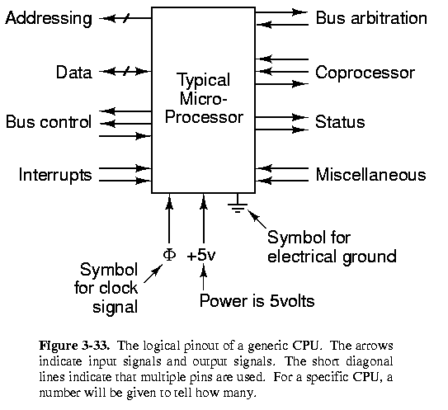
Generic microprocessor

Slide 7
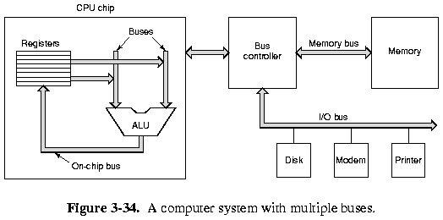
Buses

Slide 8
Computer Buses
A bus is an electrical medium for transmitting and receiving data and control signals among a set of devices, e.g., CPU, memory, video board, etc
A bus protocol must specify what its physical, electrical and timing properties are and how it works with all the devices.
In bus design the issues include
  1. Bus width
  2. Bus clocking:
    a. synchronous
    b. asynchronous
  3. Bus arbitration
  4. Bus operations: interrupts

Slide 9
Computer Buses
Like microprocessors, buses have data, address, and control lines; however, not always 1:1 correspondence.
  need decoders between:
    microprocessor
    control lines
    bus
Bus drivers:
  receivers, transceivers
  amplify signals

Slide 10
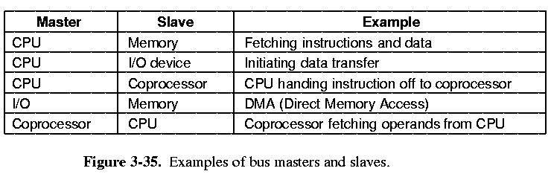
Master / slave
Broadly speaking, devices may be classified as:
  masters - those that initiate data transfers, or
  slaves - those that wait for requests;
  some devices can act as a bus master and a bus slave, but not at the same time.

Slide 11
Bus width
n address lines --> 2^n memory locations
  but larger buses more expensive
  witness problem with back-compatibility with Intel: [3-36]
  20 bit - 1 Mb; 24 bit: 16 Mb
Total data lines grows over time
2 ways to increase data bandwidth
  1. faster bus cycle time
    but skew (varying line times)becomes a problem.
    plus device back-compatibility.
  2. more data lines
Adding more data easier way to increase data bandwidth
  One technique: multiplexed bus
    lines are treated as address in some cycles, and data during others
    cheaper bus (smaller); but slower bus

Slide 12
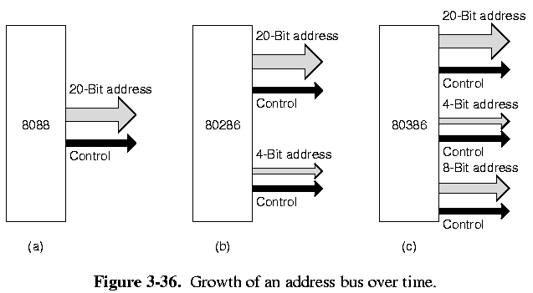
Bus width

Slide 13
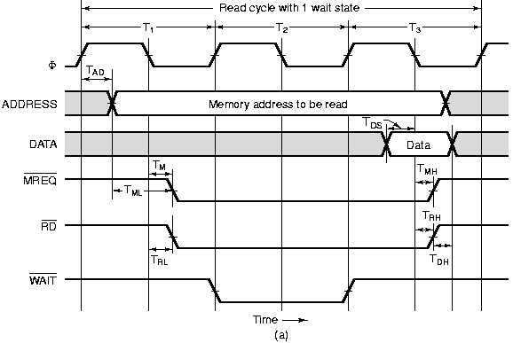
Clocking: Synchronous Buses
A synchronous bus has a line driven by a master clock, and all bus activities are taken from bus (clock) cycles.

Slide 14
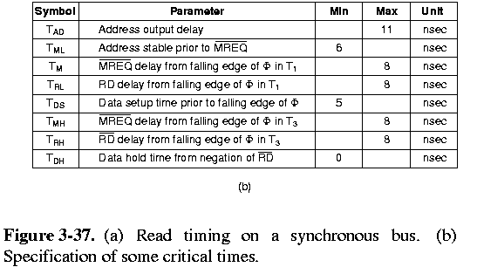
Clocking: Synchronous Buses

Slide 15
Synchronous Buses
• cycles can vary in duration, vary between devices
• signal changes not instantaneous
• Steps (in figure):
1. address set
2. MREQ (“memory”), RD asserted : T1
3. memory puts data value : T2 (“wait” in machine)
4. CPU reads data lines, negates MREQ, RD : T3 (mem negates WAIT)
• timing crucial - determines compatibility,
cost of components, performance,...
- must select memory that conforms to timing specs.
• increase efficiency:
- block transfers: one cycle per data word
- speed up clock (hardware limitations!)
- increase bus data width
• Advantages: relatively cheap & easy to design
• Problems:
- timing is critical
- no fractional cycles
- slowest devices slow down system
therefore can't use modular hardware
improvements

Slide 16
Synchronous Buses
Cycles can vary in duration, vary between devices signal changes not instantaneous
Steps (in figure 3.37):
  1. address set
  2. MREQ (“memory”), RD asserted : T1
  3. memory puts data value : T2 (“wait” in machine)
  4. CPU reads data lines, negates MREQ, RD : T3 (mem negates WAIT)
timing crucial - determines compatibility, cost of components, performance,...
  must select memory that conforms to timing specs.

Slide 17
Synchronous Buses
To increase efficiency:
  block transfers: one cycle per data word
  speed up clock (hardware limitations!)
  increase bus data width
Advantages:
  relatively cheap
  easy to design
Problems:
  timing is critical
  no fractional cycles
  slowest devices slow down system therefore can't use modular hardware improvements

Slide 18
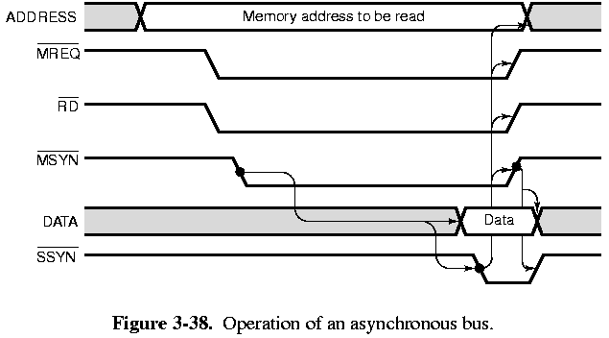
Asynchronous Buses
An asynchronous bus has no master clock;
  uses a handshake protocol between a master and a slave device.
  After the master asserts the ADDRESS, MREQ and RD lines,
  then asserts a special master synchronization line, MSYN and waits for a response from the slave on a slave synchronization line, SSYN.
  When the slave device sees MSYN, it performs the necessary operation and asserts the SSYN when it is done.

Slide 19
Asynchronous bus
full handshake:
  1. MSYN asserted
  2. SSYN asserted in response
  3. MSYN negated in response
  4. SSYN negated in response
Advantages:
  relatively independent of timing (other than skew times)
  bus can take advantage of faster devices (unlike synchronous buses)
Disadvantage: more complex to build
  eg, memory chip design and CPU design are interwoven
Synchronous buses more common.

Slide 20
Current memory transport systems
Hyper transport.
  Combines Asynchronous with packet based transfer
    512 byte or larger packets
    Mimics HTTP packets only on a high speed local link.
  Gives a point to point link between CPUs and/or memory.
  Allows large quantities of information to be transmitted between the CPU (memory controller) and the Memory.
PCI express
  External Bus system which is packet based, over multiple channels.
  Uses asynchronous communications

Slide 21
Bus Arbitration
When multiple devices want to be the bus master, we need some bus arbitration mechanism to prevent chaos.
A centralized arbitration
  dedicated bus arbiter, who determines which device is the next bus master; hence, every device connects to the bus arbiter with one (or more) bus request and one (or more) bus grant lines.
  priority of device = position on chain: closer devices have higher priority --> “daisy chain”
  can use multiple bus request and grant lines; each set represents a priority, and devices hooked up according to priority needs.
  if multiple priority levels are being requested, arbiter grants bus to higher priority line.
  each priority line is daisy chained.

Slide 22
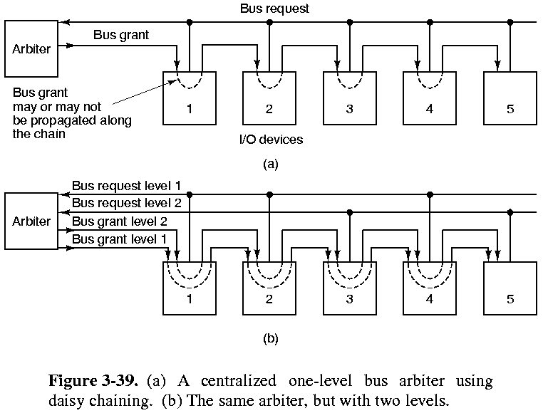
Bus

Slide 23
Bus
A decentralized arbitration scheme has no arbiter;
  the devices themselves would follow a specific protocol to determine who goes next.
Multibus: variation of daisy chain
  3 lines: request, busy, arbitration
  to use bus, device checks if busy is free and IN arbitration is asserted --> if yes, then OUT is negated
  all devices downstream are not permitted to use bus until OUT asserted
  BUT if device upstream negates OUT, this preempts this device --> daisy chain structure

Slide 24
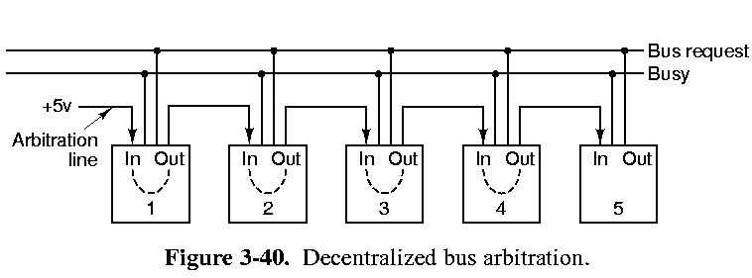
Decentralized Bus

Slide 25
Operations: Bus contention, interrupts
bus contention: "lock" command can be used for semaphore commands.
  a special line is asserted which holds the bus for one multiprocessor, in order to access shared memory data structures.
interrupts:
  when I/O device done, it issues interrupt on bus.
  multiple interrupts possible: an arbitration scheme used like bus arbitration.
  eg. assign device priorities.

Slide 26
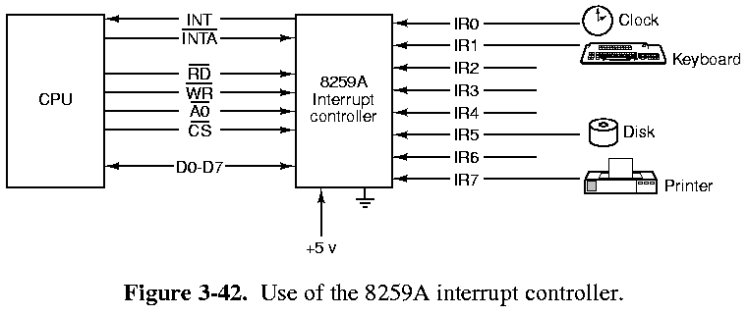
Operations: interrupts
interrupt controller: between CPU and devices to arbitrate interrupts
  eg. Intel 8259A
when device asserts 1 of 8 interrupt lines, controller asserts INT and places device # on D0-D7 lines
  CPU access interrupt vector and calls interrupt handler
  can cascade controllers: 2 stage = 64 devices

Slide 27
APIC Chip
Stand alone or integrated into CPUs
Contains upto 255 interrupt vectors.
Can Map Real and logical interrupts.
  Map physical interrupts from devices to the CPUs logical Interrupts.
  Useful for PnP systems.
Contains a high-resolution timer.
Later versions support virtualization to reduce client latency.

Slide 28
Example Microprocessor pinouts
Motorola 68000 family
68000 - 32 bit architecture, 16 bit databus
68020 - 32 bit arch, 32 bit databus, minor enhancements
68030 - data cache, memory mgmt on chip
68040 - fp, highly pipelined
68020/30

Slide 29
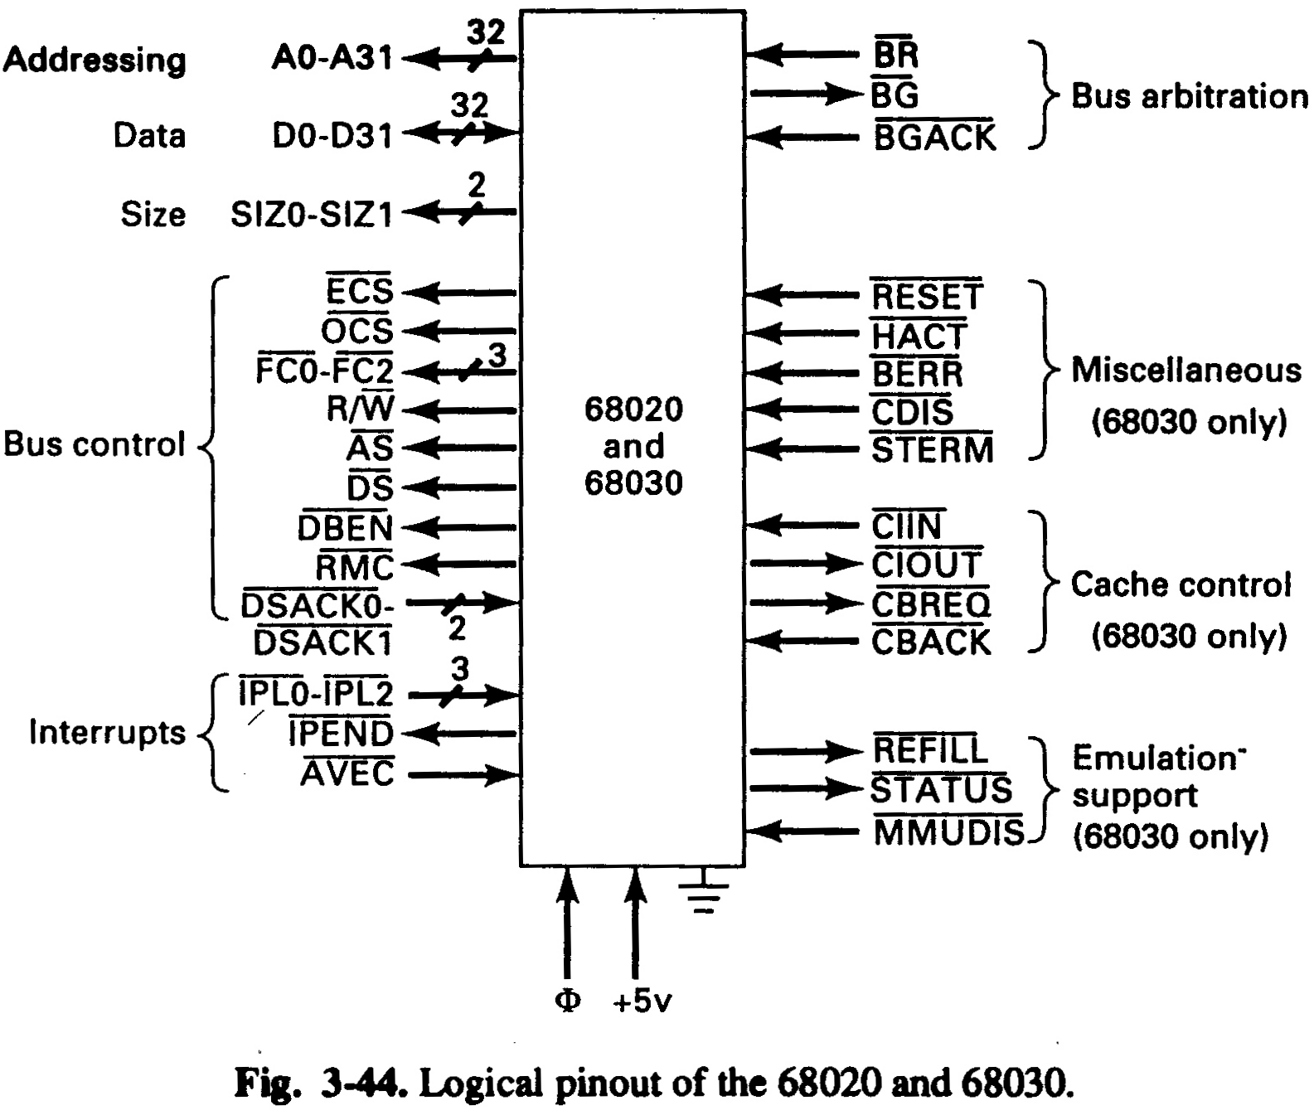
68020

Slide 30
Motorola pinout
32 address, 32 data, opsize pins SIZ0-SIZ1
bus control:
  ECS - ext cycle start, to show start of cycle to devices
  OCS - operand cycle start, asserted on 1st R/W cycle
  FC0-FC2 - type of bus cycle (eg. mem read or write,
  I/O port read, write, release bus, ...)
  R/W - read or write cycle
  AS - address strobe, ass’t when lines are stable
  LOCK, RMC - multiprocessor control
  DSACK0,1 - data & size ACKnoledge, input to mp when device finished read
  IPL0-2 - 7 interrupt level settings (0 not used)
  BR, BG, BGACK - bus arbitration
  BERR - error, eg. access nonexistent memory
  CDIS - disable internal cache
  and others

Slide 31
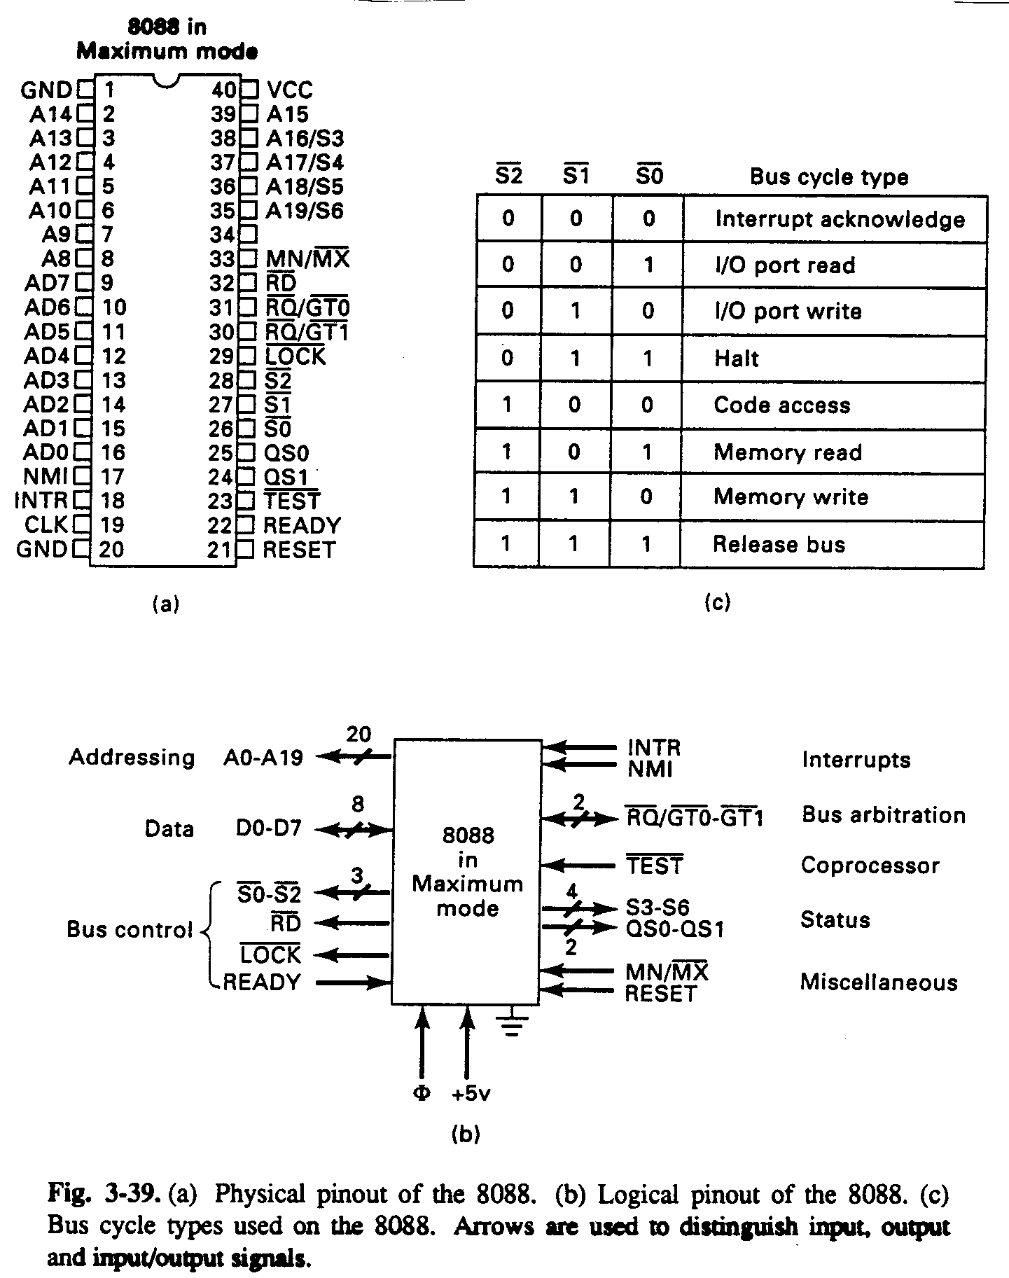
Intel pinouts
80x86 family
  8088 - 16 bit data architecture, 8 bit data bus
  80286 - 16 bit data bus, modes, faster
  80386 - 32 bit arch/bus, 4 gigabytes mem, faster
  80486 - fp processor, cache, pipelined
  Pentium - 64 bit data path, more RISC technology

Slide 32
8088 Pinout
to fit into 40 pins chip, many lines are multiplexed
  A0-7, D0-7 - swap values on different bus cycles
  16 bit words read/written in separate byte per cycle
  A16-19 multiplex with status S3-6
other pins:
  bus control: S0-S2 - bus status (type of cycle)
  RD - read
  LOCK - exclusive use of bus
  READY - neg’d by slow memory when not ready
interrupts:
  INTR - device interrupt (maskable)
  NMI - non-maskable interrupt
bus arbitration: RQ/GTx - request, grant
and others

Slide 33
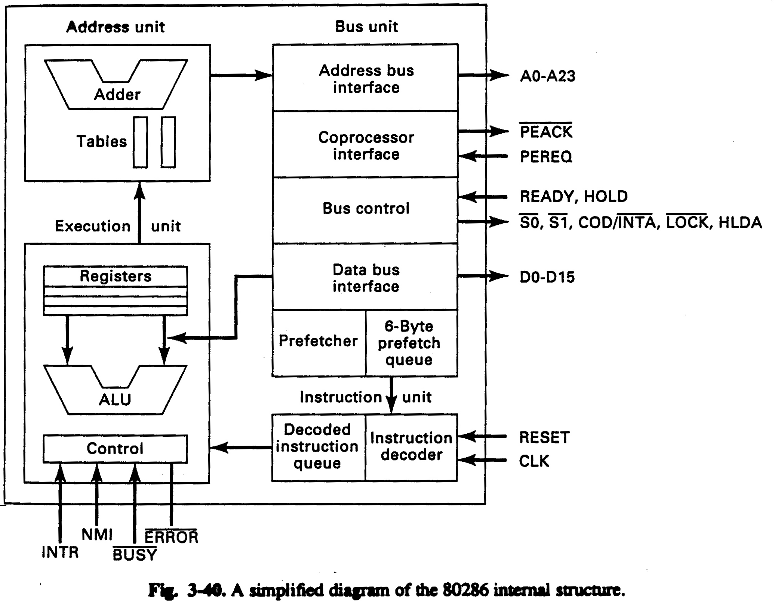
Intel 80286

Slide 34
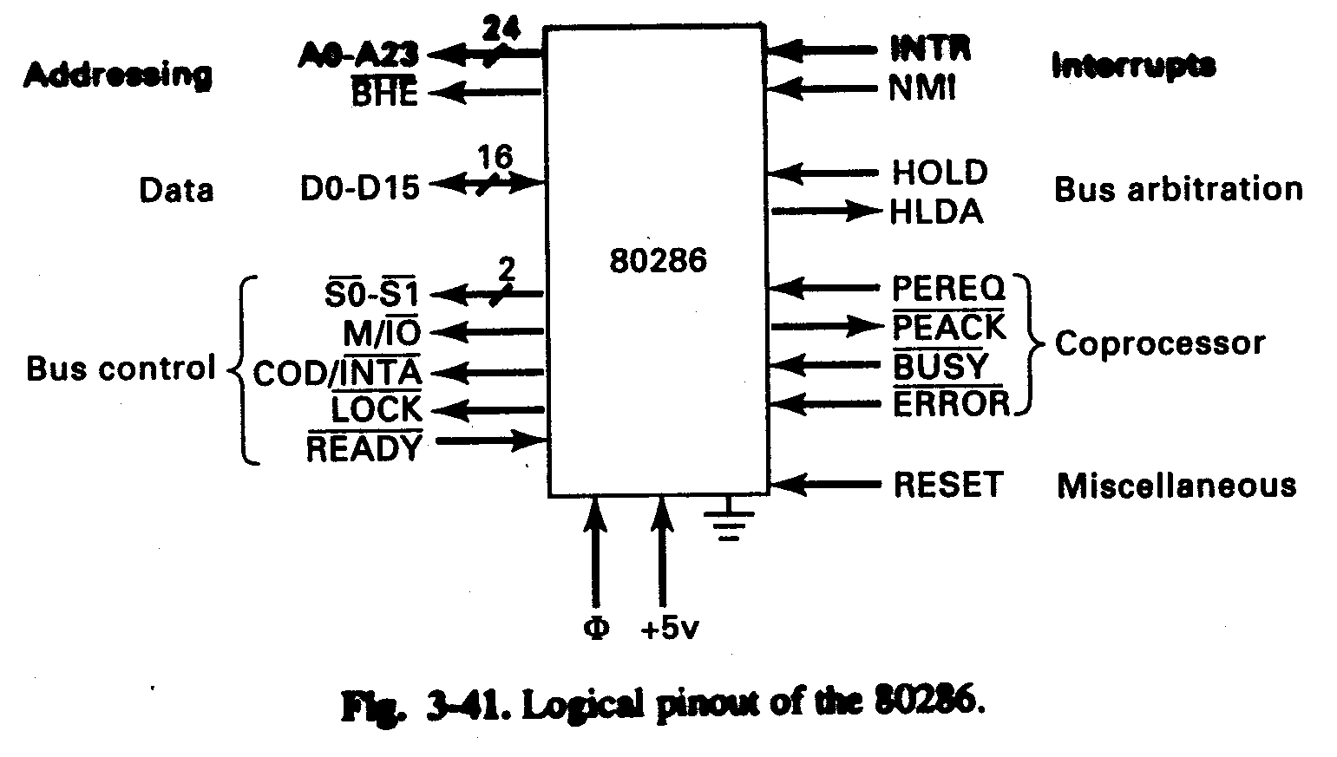
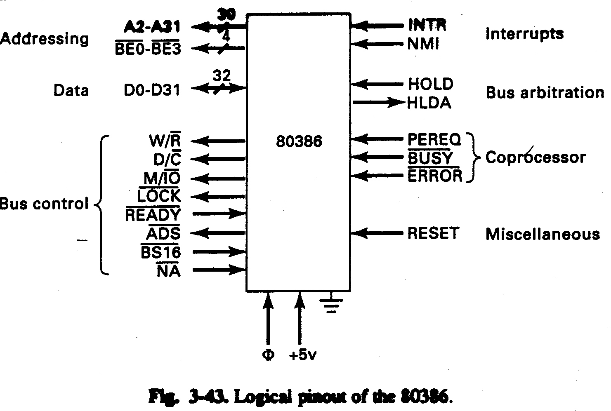
Intel 80286 & 80386 pinout

Slide 35
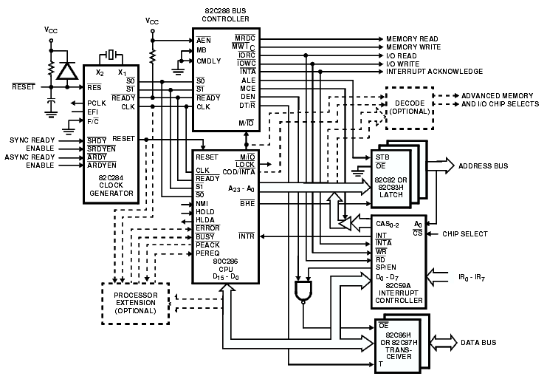
80286

Slide 36
Intel pinout
80286
  4 modules on chip:
  i) bus unit - all bus operations, I/O, processor comm.
  ii) instruction unit - reads & decodes instructions (buffers 3 at once)
  iii) execution unit - executes decoded instns.
  iv) address unit - address computations, virt. mem.
pins: square 64 pins (earlier 8088 would multiplex some pins in which pins had different functions in different cycles)
  24 address, 16 data
  BHE - enables writing 1 byte into 2 byte word in mem, w/o overwriting high byte
  S0,S1 - type of bus cycle
  LOCK - locks bus
  READY - input from memory, permits memory to stall CPU until data is ready (for slower mem)
  HOLD, HLDA - bus arbitration
  PEREQ,PEACK - coprocessor communication
  others

Slide 37
Intel pinout
80386
  8 modular units on chip
pins:
  30 address, 32 data
  note: address must be aligned on 4-byte boundary (low 2 are = 0)
  BE0-3 - indicates which byte in 32-bit word to write to
  3 bus control (not 4)
  BS16 - slow system down for older 16 bit I/O chips
  NA - next address, to speed up memory access (pipelining)

Slide 38
Comparing 68030 and 80386 H/W
both are functionally similar wrt pinout; some differences...
  68030 can address any byte; 80386 cannot since low order bits of address always 0 (strange, since it uses 4 extra BE lines!)
  bus control differ, eg. 68030 tells devices more about bus cycles; 386 requires devices to find out themselves
  68030 has 7 maskable interrupt levels; 386 has 2
  and others

Slide 39
Pentium II
7.5 million transistors (8088 = 29k trans)
full 32-bit CPU
  but data transfer of 64 bits
64 Gb address space
242 connectors on SEC (single edge cartridge)
2 external synchronous buses:
  memory bus
  PCI bus (for I/O)
  possibly an ISA bus attached to PCI bus
Pinout: [3.44]
  170 signals, 27 power connections, 35 grounds, 10spares for future
Bus signal lines:
  1. bus arbitration
  2. request (addressing)
    36 bit addresses, but low 3 bits always 0 --> 64 GB
  3. error: used by slave to report errors
  4. snoop: multiprocessor cache synchronization
  5. response: slave communication to CPU
  6. data

Slide 40
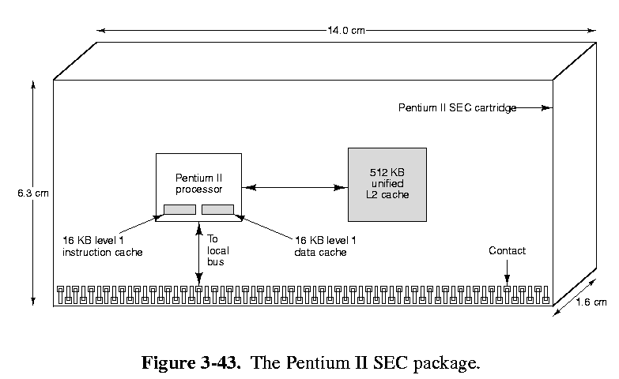
Pentium II

Slide 41
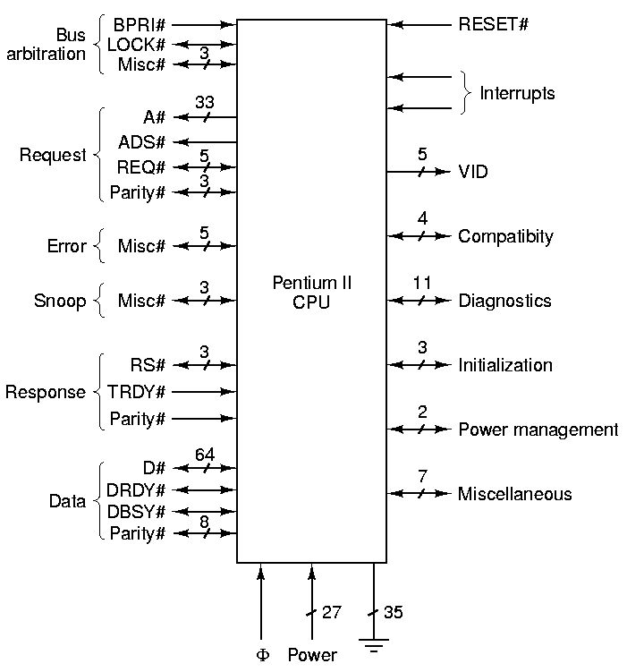
Pentium II
Fig. 3-44 Logical pinout of the Pentium II. Names in upper case are the official Intel names for individual signals. Names in mixed case are groups of related signals or signal descriptions.

Slide 42
Pentium II
Misc control lines
  Reset
  interrupts
  VID - power selection (can vary)
  compatibility: for old devices
  Diagnostics: for testing
  initialization: booting
  power mgmt: put CPU to sleep
  misc

Slide 43
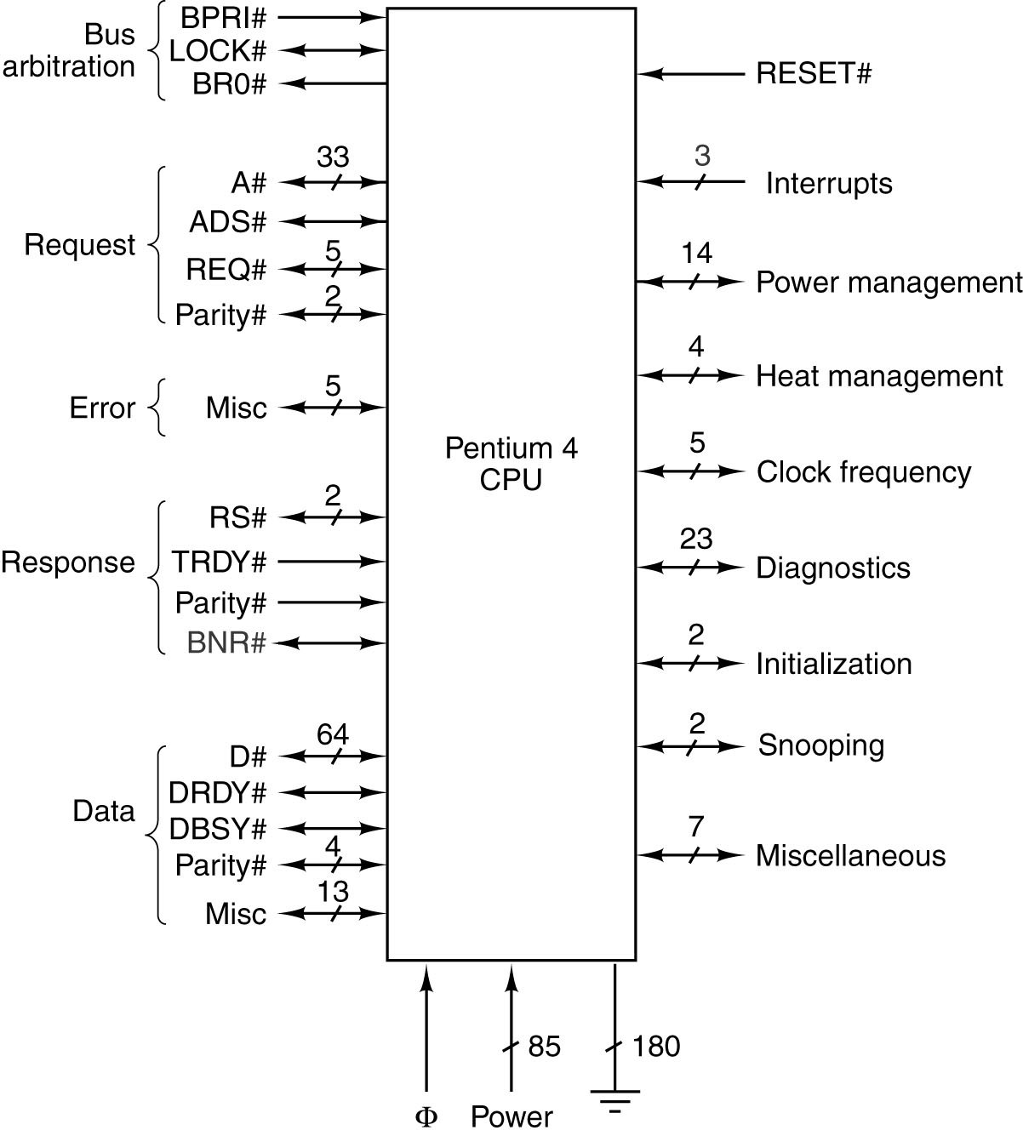
The Pentium 4’s Logical Pinout
Logical pinout of the Pentium 4. Names in upper case are the official Intel names for individual signals. Names in mixed case are groups of related signals or signal descriptions.

Slide 44
Pentium 4
478 Pins, 3.8 GHz. 178M Transistors (Extreme Edition. Feb 2004.)
  Single processor with 2 separate internal CPU systems.
2 pipelines for inst. Processing
  Hyper Threading, application can use 2 processors.
64 data lines, 8 byte.
36 bit address, 33 Adr. Lines, lower 3 bits are always 0, causing word alignment.
Cache: L1 8Kb, L2 256K to 1Mb, (L3 2Mb Extreme Edition)
5 Levels of sleep, to conserve power.
Pipelined memory bus.
More instructions for 3D graphics and media
Enhanced bus control: 1066 MHz at 8.4 Gb/sec.
CPU monitoring, temperature, errors etc.

Slide 45
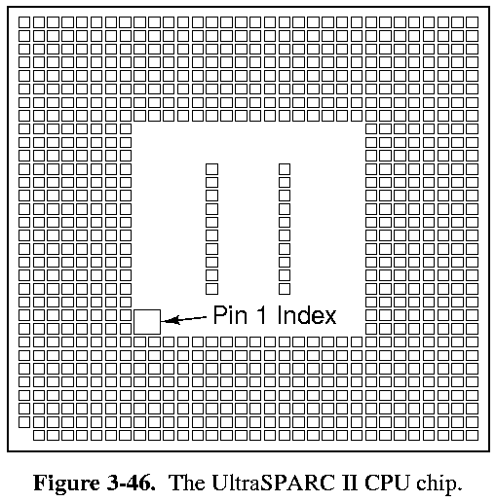

UltraSPARC II
Fig 3-46, 4th edition,
Ultra SPARC II, 787 pins
Fig 3-47, 5th edition,
Ultra SPARC III, 1388 pins

Slide 46
UltraSPARC II UltraSPARC III
64-bit RISC used by Sun
inherently 4-CPU multiprocessors w/o extra hardware
5.4 million transistors
787 pins: 64 address, 128 data
Caches:
  2 internal: 16K data, 16K instructions
  off-chip level 2 cache: 514 Kb to 16 Mb (more flexible than PII, but slower)
Memory access via UPA (Ultra Port Architecture)
  different implementations, but one specification
  faster than main I/O bus (SBus)
64-bit RISC used by Sun
inherently 4-CPU multiprocessors w/o extra hardware
29 million transistors
900 MHz, clock
1369 pins: 64 address, 128 data
Caches:
  2 internal: 64K data, 32K instructions
  off-chip level 2 cache: 514 Kb to 8 Mb, 256 bit bus
Instr.
  Multi Media, 3D Graphics
Memory access via UPA (Ultra Port Architecture)
  different implementations, but one specification
  faster than main I/O bus (SBus)
  UDB acts like a DMA, buffering UPA and CPU

Slide 47
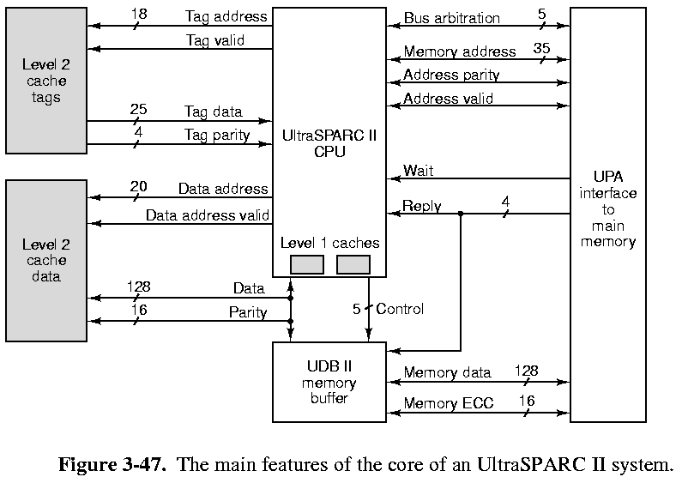
UltraSPARC II & III Core

Slide 48
UltraSPARC II & III Core
Memory access:
  cache line: 64 bytes
  1. find word in level 1 cache
  2. else look in level 2 cache
    data, instns randomly scattered
    cache tags keeps track of which lines in cache data
    if there, it is fetched in 4 cycles (16 bytes/cycle) into level 1 cache
  3. else retrieve from main memory via UPA
    UPA controller does accesses (could be multiple CPU’s accessing RAM)
    UPA can handle 2 different requests simultaneously
    address (and data) put on pins to UDB II (Data Buffer): decouples CPU from RAM
    CPU can work on other instns until UPA completes

Slide 49
8051 MicroController
Low end Controller, used in Appliances.
Designed for control i/o.
  Address 64K (8 bit) over a bus.
    256 bytes ram
    4 – 8 kb onboard rom
  32 i/o lines
    Arranged a 4 ports which can be programmed
    Interface to switches, sensors, LEDs etc.
    Act, as Address or Data.
If program is small enough, 1 chip does everything.

Slide 50
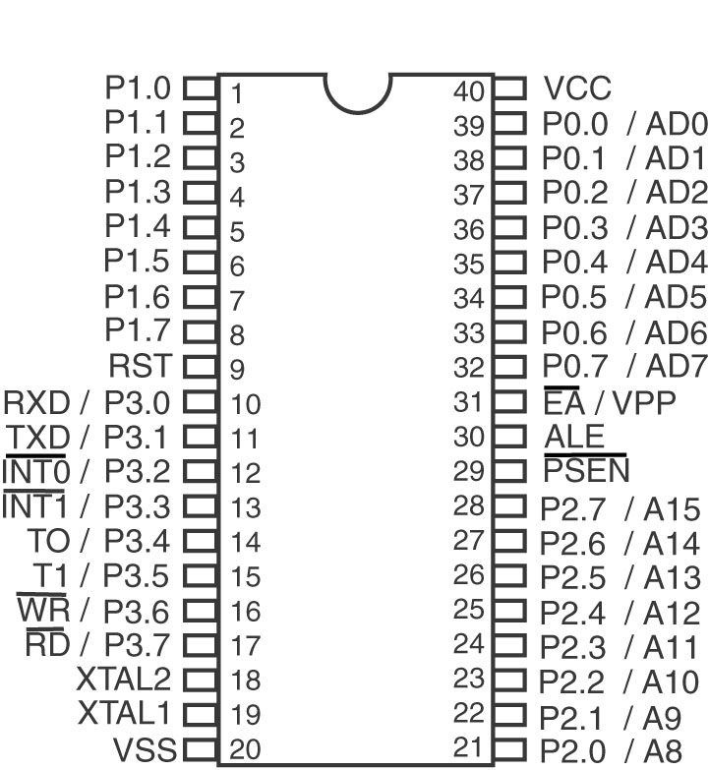
The 8051 (1)
Physical pinout of the 8051.

Slide 51
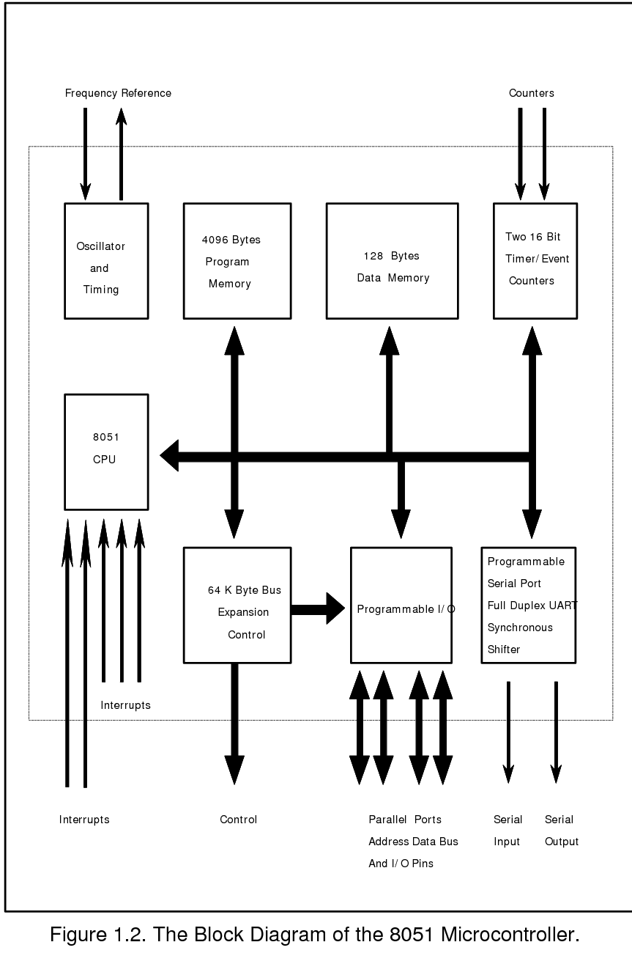
8051 Block
Diagram
Programmable i/o ports, Can be:
  Address
  Data
  Control
  Depends on programming

Slide 52
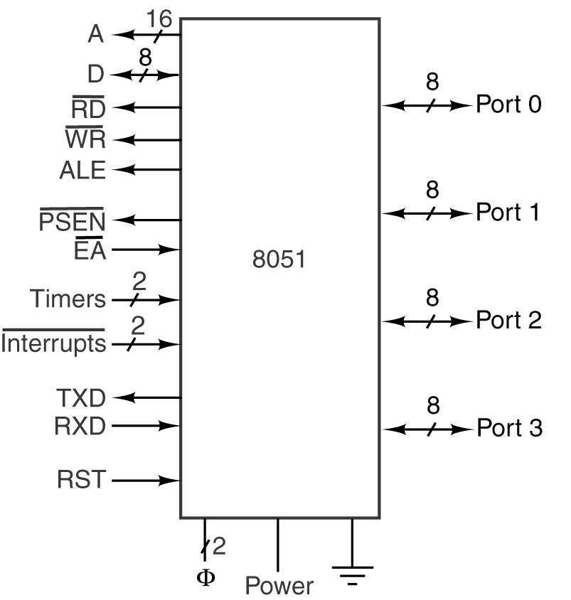
The 8051 (2)
Logical pinout of the 8051.

Slide 53
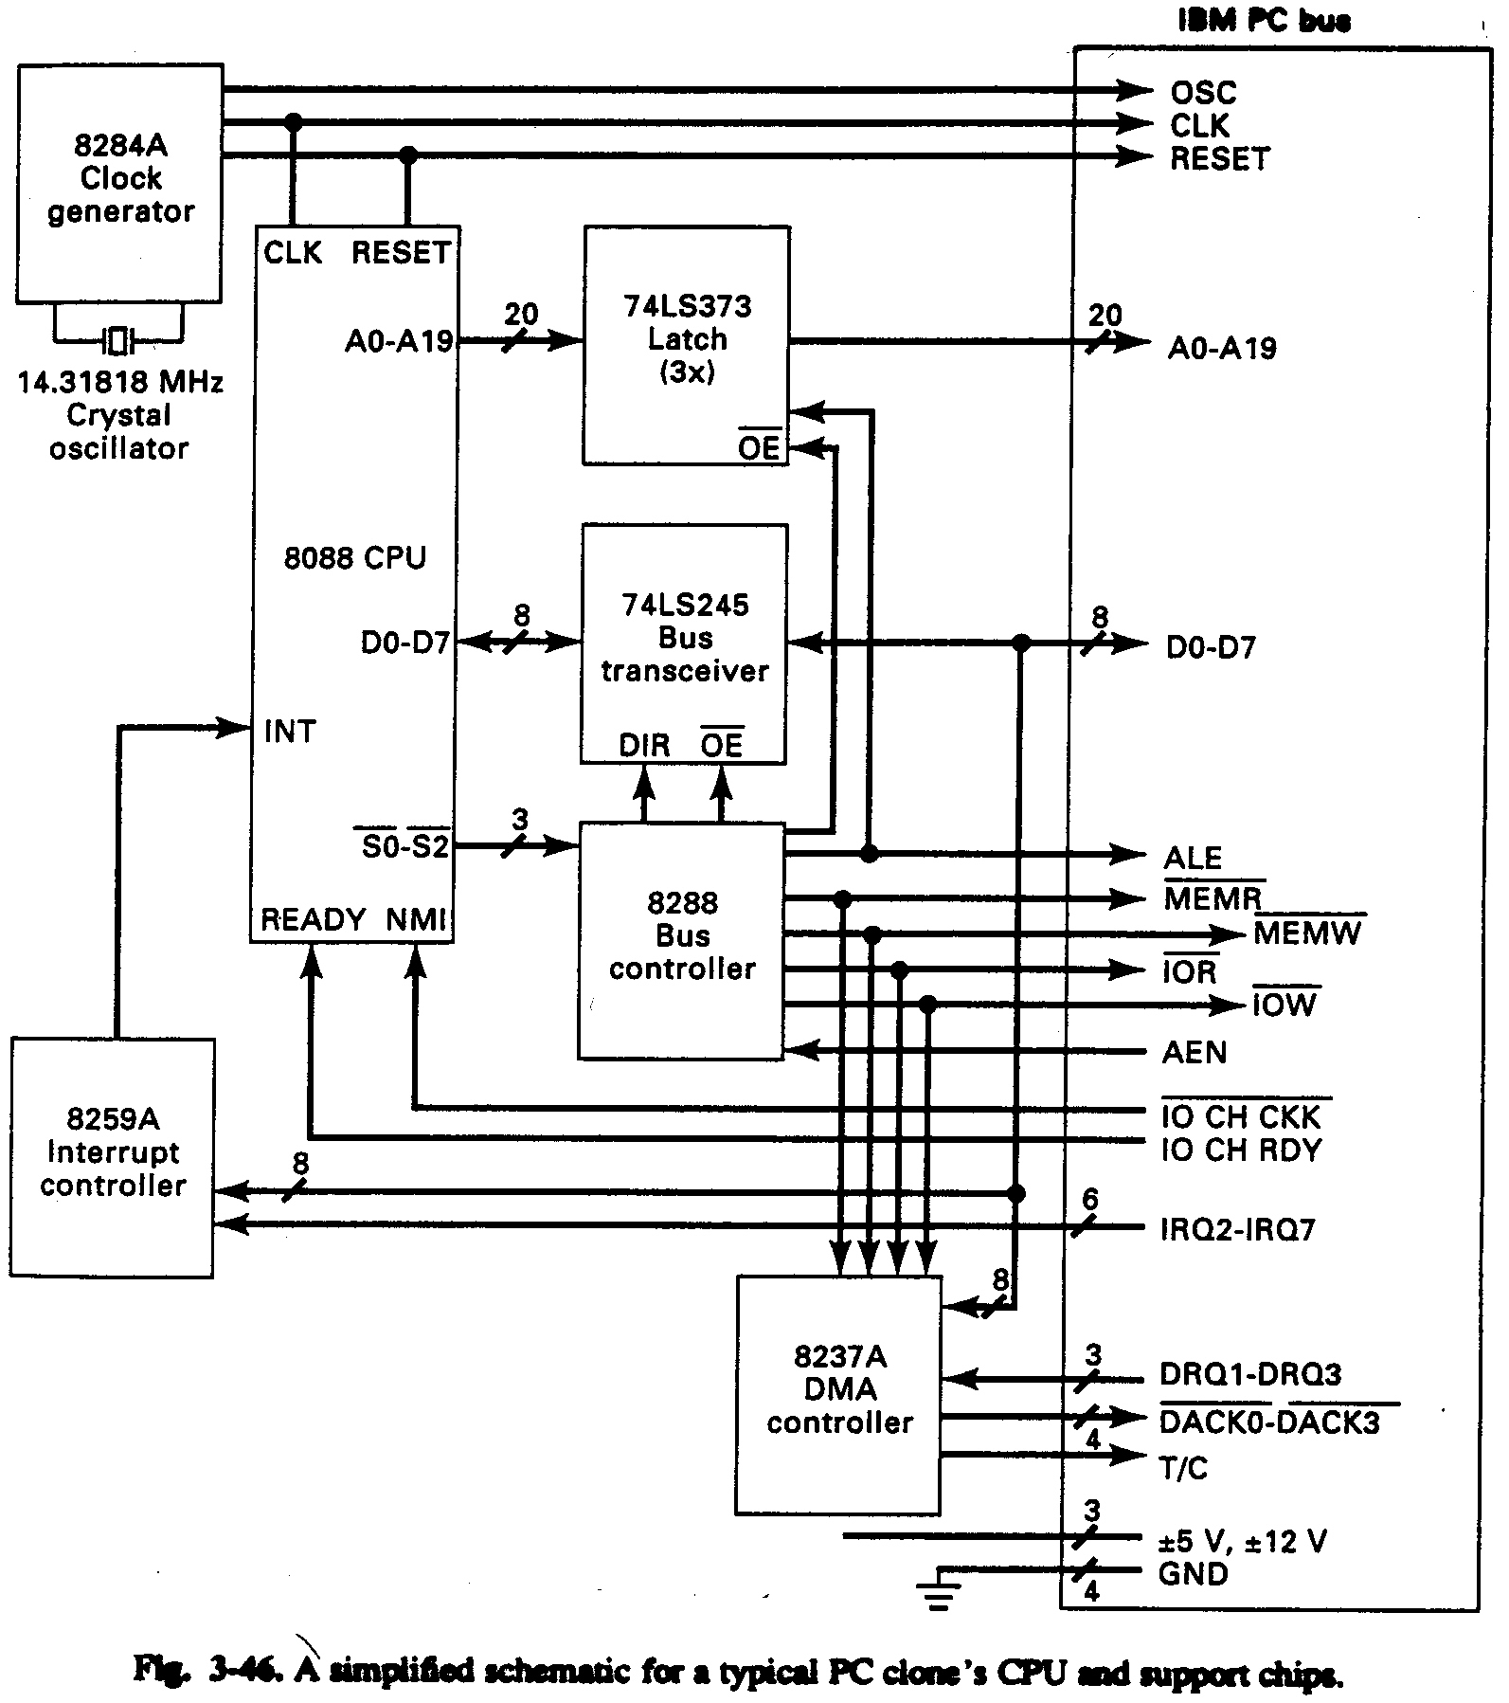
Example buses: IBM PC

Slide 54
IBM PC
62 lines (20 addr, 8 data, 34 control)
  data are only bi-directional lines
synchronous bus: clock rate of 4.77 MHz (a multiple of another clock set to video MHz)
latches required because of multiplexing of pin signals: hold values until their part of cycle.
transceivers used for addr, data lines because MOS 8088 is too weak for reading & sending signals on bus.
bus has 2 address spaces - I/O, or Memory (MEMR, MEMW, IOR, IOW control)
  Intel’s explicit identification of I/O vs memory will be seen in instruction set as well

Slide 55
IBM PC
8237A: DMA controller chip
  logic for bus protocol, DMA, block xfer
  8088 sends it addr, device, counts, etc for DMA transactions
80286 expansion (IBM AT): --> ISA (Industry Standard Architecture) bus
  1st connect half = 8088
  2nd half has 36 new lines (more data, addr, interrupt, DMA channels,...)

Slide 56
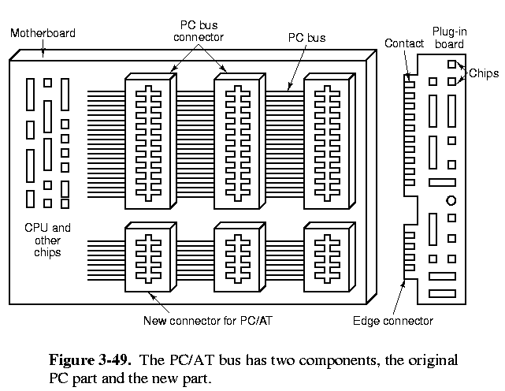
Later PC buses

Slide 57
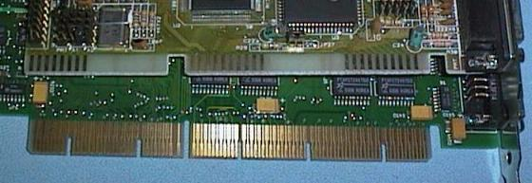
Later PC buses
PS/2 series - Microchannel bus totally redefined and patented
  IBM’s attempt to discourage clones; but PS/2 not too successful
EISA - Extended ISA
  industry (non-IBM) extension of ISA to 32-bit data transfer
  still back-compatible

Slide 58
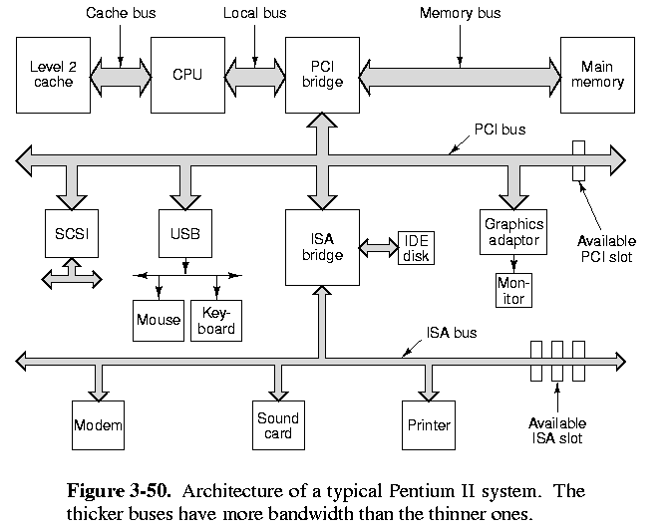
PCI Bus

Slide 59
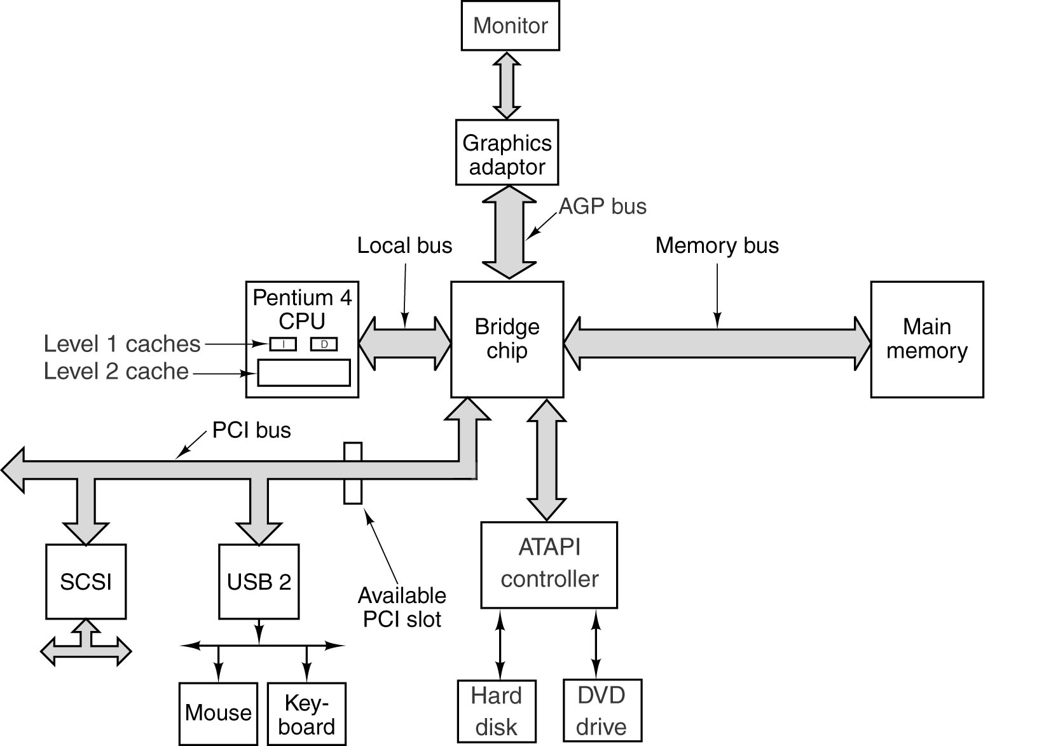
The PCI Bus P4
The bus structure of a modern Pentium 4.

Slide 60
PCI Bus
high bandwidth bus, suitably for multimedia
  ISA: 8.33 MHz, 2 bytes/cycle --> 16.7 MB/sec
  EISA: 4 bytes/cycle --> 33.3 MB/sec
  but full video requires:
    2 * (1024x768 pixels/frame)*3 bytes/pixel*30 frames/sec = 135 MB/sec
    (must xfer from HD to mem, then to video card, all on same bus!)
PCI 2.1 (1995):
  66 MHz
  64 bit transfers
  bandwidth: 528 MB/sec
Typical PC systems:
  up to 133MHz+; 250MHz+ in workstations(Suns)
  PC’s still have old ISA buses:
    access via ISA bridge(s)
    access to IDE disks, old slower peripherals
  dedicated fast access to memory
  PCI access to graphics, SCSI, USB, ...
PCI cards come in 2 different versions, and 32 and 64 bit versions (have 120 pins and 120+64 pins resp.)
buses and cards can run at 33MHz or 66 MHz
synchronous
multiplex address and data pins

Slide 61
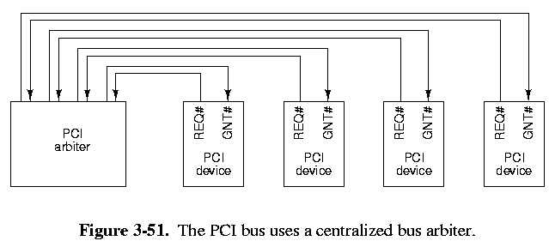
PCI Bus Arbitration
centralized bus arbiter
  REQ#: device requests bus
  GNT#: arbiter asserts to grant bus to device
  no arbitration algorithm specified (can be round robin, priority, ...)
Transactions:
  normally 1 transaction per req/grant, with intervening wait
  longer or back-to-back xfers possible

Slide 62
PCI Bus Signals
Some signals:
  multiplexing: cycle 1: addr; cycle 3: data
  C/BE#: (i) cycle 1 = bus command (read 1 word, etc.)
    (i) cycle 2 = bit map of 4 bits telling which bytes are valid in 32-bit word
  FRAME#: master sends to start trans, indicate addr and cmd lines are valid
  IRDY# = master ready to accept data
  IDSEL = select config space (device descr, “plug & play”)
  DEVSEL# = slave has read address
  TRDY# = data for read ready, or ready to accept data for write
  64-bit signals: expanded trans for 64 bits

Slide 63
PCI bus transactions
very similar to earlier example of synch bus timing
actions occur on falling edges of clock
T1:
  master puts addr on AD, read command on C/BE#
  then FRAME# to start transaction
T2:
  master ‘floats’ addr bus so slave can put data on it
  C/BE# changed to indicate which bytes are to be enabled
T3:
  slave asserts DEVSEL# (it got the address)
  puts data on AD lines, and asserts TRDY# when done
  (will wait until next cycle if it can’t do in time... wait state)

Slide 64
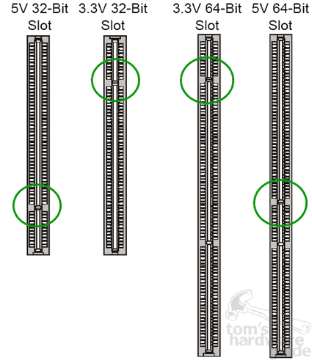
PCI

Slide 65
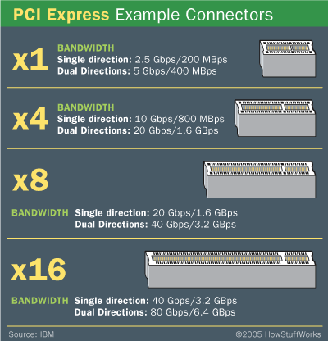
PCI-Express

Slide 66
USB
Users do not have to set switches & jumpers
Installation of new device is to external port connections. (don’t have to open the case)
1 cable
Devices are powered from the cable.
127 different devices/bus
Support for real time devices (live video & audio)
Hot insertion and removal
Installing does not require a reboot
Cheap.

Slide 67
USB.
Ver 1.1
  1.5 Mbps – low data transfer rate.
  12 Mbps – high data transfer rate.
Ver 2.0 480 Mbps
  Fire wire (IEEE) runs at 400 Mbps
Synchronous bus
  Broadcasts a sync frame from root every 1msec.
    Control
    Isochonous – real time devices
    Bulk – general data tx. Like memory keys
    Interrupt – poling devices like kbd.
Isochrony
  Devices bandwidth on the bus is guaranteed.

Slide 68
VME bus
Versa Module Eurocard
  was used in older workstations, scientific equipment (back in early 80’s onwards to...?)
asynchronous bus: max. effective clock of 10 MHz (skew occurs with faster speeds)
rigorous standardization & open architecture
  (Apple’s Nubus is comparable in design, performance)
three parts:
  VME bus: main bus
  VSB bus: smaller local bus
  VMS bus: slower serial bus
VME lines:
  1. Data
  2. bus arbitration
  3. priority interrupts
  4. utilities

Slide 69
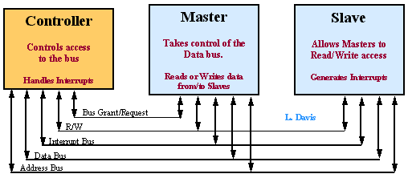
VME bus
VME Bus Description http://www.interfacebus.com/Design_Connector_VME.html
The VME bus is a scalable backplane bus interface.
Cards may be produced which respond to the following
Address widths or Data widths:
A01 - A15 D00 - D07
A01 - A23 D00 - D15
A01 - A31 D00 - D23
A01 - A40 D00 - D31
D00 - D63 (undefined before Rev. C)

Slide 70
VME
1. Data transfer
  8, 16, 32 bits data, 16, 24, 32 bits address
different bus cycles:
  1,2,4 bytes instructions
  unaligned transfers
  block transfers
  indivisible read/write (multiprocessing)
  address only - prepare memory for trans.
devices types:
  master/slave
  location monitor: watches addr lines for value
  bus timer: to watch for hung up cycles, and kill if necessary

Slide 71
VME
2. Bus Arbitration
techniques supported:
  single daisy chaining
  fixed priorities
  round robin
3. Priority interrupts
  7 priorities, 1 daisy chain grant line
  interrupt controller chip arbiters interrupts
4. utilities:
  clock (for measuring performance) etc

Slide 72
Comparing VME and IBM PC
PC: synchronous, VME: asynchronous
  - VME has effective minimum cycle time of 100 nsec, vs PC’s 210
  - also, PC transfers 8 bits, not 32; thus VME throughput is almost 40 times greater
PC: card connectors; VME: actual pin sockets
  - pins are much less prone to bad connections; more expensive thoughVME has automatic bus
VME has automatic bus testing, shutdown
VME has separate bus board; PC has bus chips on motherboard.

Slide 73
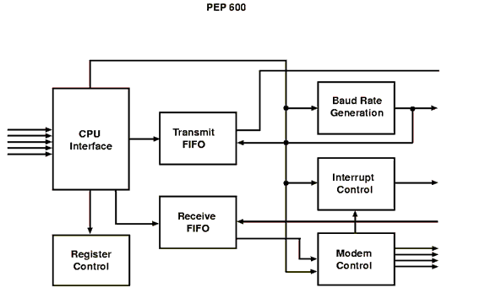
Other I/O devs.
UART (Universal Asynchronous Receiver Transmitter).
  RS232 serial communications
  From PCI or ISA to modem or null modem communications.
  16550 chip

Slide 74
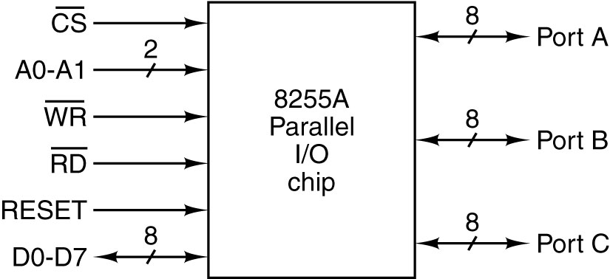
Other I/O devs.
PIO (parallel Input/Output).
  Printer communications
  8255A

Slide 75
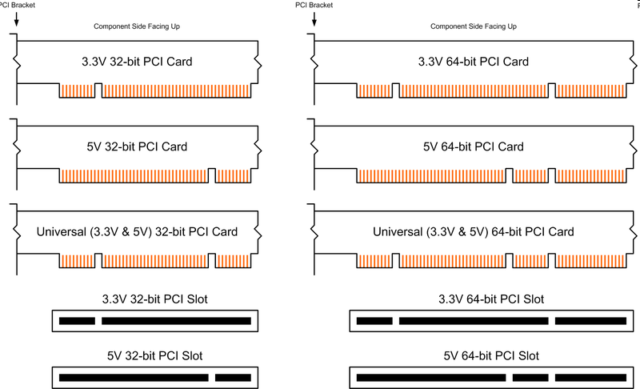
PCI

Slide 76
The end

